Slide 1

PCF Training – Level 0
Sesión 2
Práctica 1
Ángel Álvarez Valdeolmos
22/05/2019

Slide 2
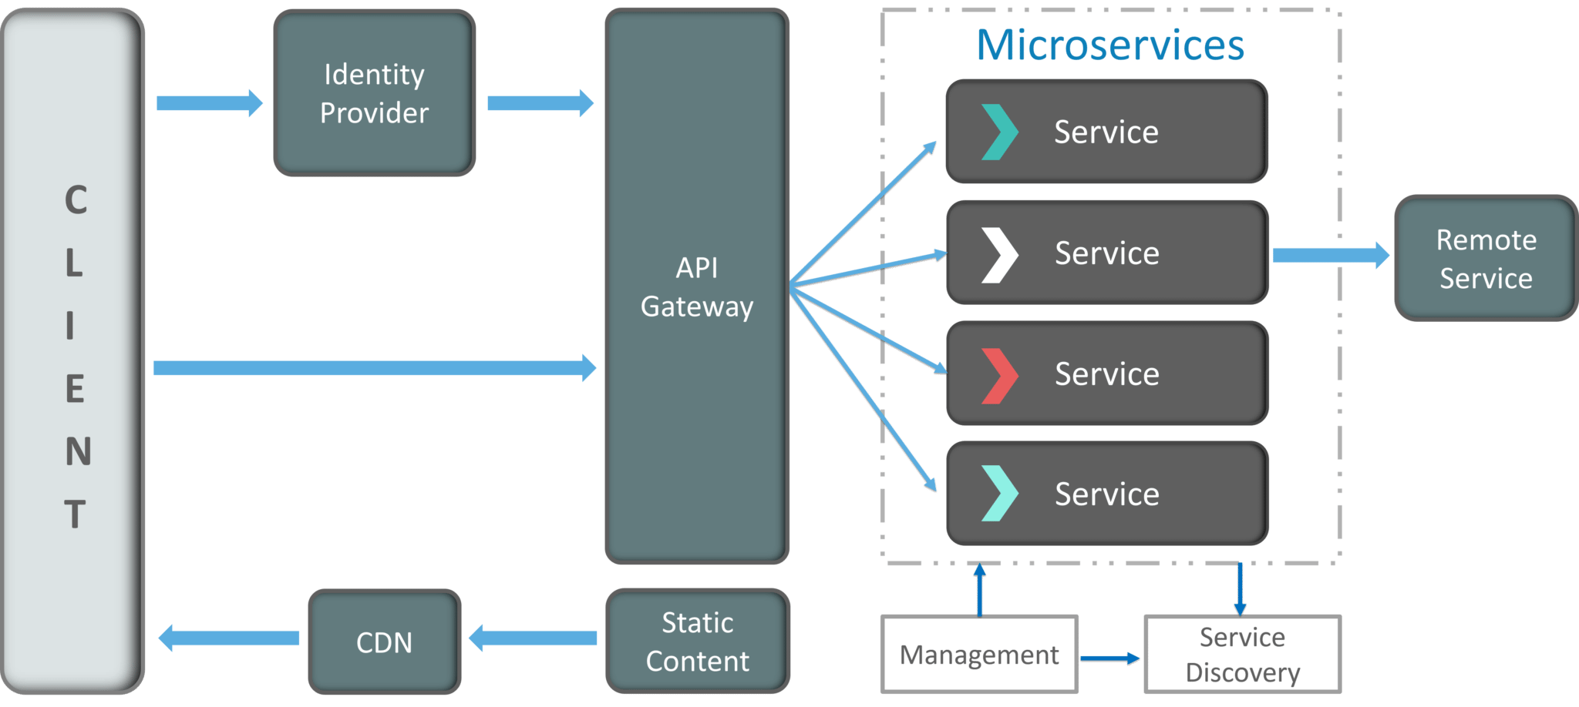
Microservices Architecture

Slide 3
Microservices Architecture

Slide 4
On-line shop
Departamento de Catálogo: Añaden productos disponibles para comprar. Formado por Managers (Les encantan las métricas y las alertas)
Departamento de Stock (almacén): Escanean los productos cuando entran y se los entregan a los repartidores.
Departamento de Envíos: Gestionan los envíos de productos.
Departamento de Repartidores: Gestionan los repartidores libres/ocupados.
Departamento de Clientes: Dan de alta a clientes y gestionan su crédito (prepago)
Departamento de Pedidos: Reciben y gestionan las peticiones de los clientes.

Slide 5
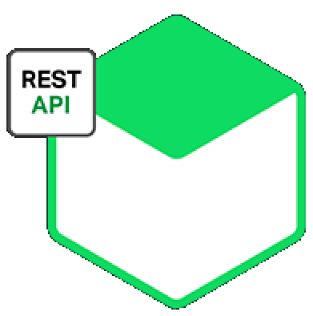

SHIPMENT
STOCK
DELIVERY
ASYNCHRONOUS CHANNEL
ORDER
CUSTOMER
CATALOG

Slide 6
Equipos
SHIPMENT
Patrick
DELIVERY
Enrique
STOCK
Carlos
CUSTOMER
Rob
ORDER
Cesar
CATALOG
Jorge

Slide 7
Use Cases
Catalog CreateNewProduct ReadProduct ReadAllProducts ReadMetrics StockHasBeenReservedForThisProduct StockHasBeenAddedForThisProduct StockIsOverForThisProduct Customer CreateNewCustomer AddCreditToThisCustomer ReadCustomer ReadAllCustomers CheckAndReserveOrRejectCreditForThisUser Stock AddStockToProduct ReadStock ReadAllStock CheckAndReserveOrRejectStockForThisProduct NewProductHasBeenAdded
Shipment StartShipment EndShipment ReadShipment ReadAllShipment NewOrderConfirmed StockReservedForThisShipment StockRejectedForThisShipment StockAddedForThisProduct DeliveryManAvailableForThisShipment DeliveryManNotAvailableForThisShipment DeliveryMan HireNewDeliveryMan ReadDeliveryMan ReadAllDeliveryMan ShipmentIsReadyReserveOrRejectDeliveryMan ShipmentFinish Order CreateNewOrder ReadOrder ReadAllOrders CustomerCreditValidated CustomerCreditRejected CustomerCreditChanged

Slide 8
Use Cases
Catalog CreateNewProduct ReadProduct ReadAllProducts ReadMetrics StockHasBeenReservedForThisProduct StockHasBeenAddedForThisProduct StockIsOverForThisProduct Customer CreateNewCustomer AddCreditToThisCustomer ReadCustomer ReadAllCustomers CheckAndReserveOrRejectCreditForThisUser Stock AddStockToProduct ReadStock ReadAllStock CheckAndReserveOrRejectStockForThisProduct NewProductHasBeenAdded
Shipment StartShipment EndShipment ReadShipment ReadAllShipment NewOrderConfirmed StockReservedForThisShipment StockRejectedForThisShipment StockAddedForThisProduct DeliveryManAvailableForThisShipment DeliveryManNotAvailableForThisShipment DeliveryMan HireNewDeliveryMan ReadDeliveryMan ReadAllDeliveryMan ShipmentIsReadyReserveOrRejectDeliveryMan ShipmentFinish Order CreateNewOrder ReadOrder ReadAllOrders CustomerCreditValidated CustomerCreditRejected CustomerCreditChanged

Slide 9
API
Catalog POST: api/v1/products Body: CreateProductRequest Response: CreateProductResponse GET: api/v1/products Response: ReadProductListResponse GET: api/v1/products/{id} Response: ReadProductResponse GET: api/v1/products/metrics Response: ReadProductMetricsResponse Customer POST: api/v1/customers Body: CreateCustomerRequest Response: CreateCustomerResponse POST: api/v1/customers/{id]/credit Body: AddCreditCustomerRequest Response: AddCreditCustomerResponse GET: api/v1/customers/{id} Response: ReadCustomerResponse GET: api/v1/customers Response: ReadCustomerListResponse Stock POST: api/v1/stocks Body: AddStockRequest Response: AddStockResponse GET: api/v1/stocks/{id} Response: ReadStockResponse GET: api/v1/stocks Response: ReadStockListResponse Shipment PUT: api/v1/shipments/{id]/start Body: StartShipmentRequest PUT: api/v1/shipments/{id}/end Body: EndShipmentRequest GET: api/v1/shipments/{id} Response: ReadShipmentResponse GET: api/v1/shipments Response: ReadShipmentListResponse DeliveryMan POST: api/v1/deliveryMen Body: HireDeliveryManRequest Response: HireDeliveryManResponse GET: api/v1/deliveryMen/{id} Response: ReadDeliveryManResponse GET: api/v1/deliveryMen Response: ReadDeliveryManListResponse Order POST: api/v1/orders Body: CreateOrderRequest Response: CreateOrderResponse GET: api/v1/orders/{id} Response: ReadOrderResponse GET: api/v1/orders Response: ReadOrderListResponse

Slide 10
Domain
Order
order: id, productId, CustomerId, Price, ? Catalog
Product: id, title, description, ? CatalogMetrics: ? customer
customer: id, name, credit, ? DeliveryMan
deliveryMan: id, name, shipmentId, ? Shipment
shipment: id, product, deliveryMan, status, notes, incidences, ? Stock
stock: productId, stock, ?

Slide 11
http://localhost:xxxx/console
http://localhost:xxxx/swagger-ui.html

